Slide 1

CSCE 5290
Natural Language Processing
Notes:
Lecture 5:
Language Modeling (Smoothing Techniques)

Slide 2

Probabilistic Language Models
Formal grammars (e.g. regular, context free) give a hard “binary” model of the legal sentences in a language.
For NLP, a probabilistic model of a language that gives a probability that a string is a member of a language is more useful.
To specify a correct probability distribution, the probability of all sentences in a language must sum to 1.
Notes:
What is Language Modelling?
Language modeling is a statistical technique used in natural language processing to estimate the probability of a sequence of words occurring in a given context. It involves building a computational model that assigns probabilities to sequences of words, which helps in various tasks such as speech recognition, machine translation, spell correction, and text generation.
In machine translation, the model calculates the probability of different translations and selects the most likely one.
For spell correction, the model compares the probability of different word sequences and suggests corrections based on likelihood.
In speech recognition, the model identifies the most probable sequence of words that matches the input speech signal.
These models help improve the accuracy and fluency of automated language processing tasks.
Probabilistic language models are trained on large corpora of text data to learn the likelihood of different word sequences occurring.

Slide 3
Uses of Language models
Speech recognition
- “I ate a cherry” is a more likely sentence than “Eye eight uh Jerry”
OCR & Handwriting recognition
- More probable sentences are more likely correct readings.
Machine translation
- More likely sentences are probably better translations.
Generation
- More likely sentences are probably better NL generations.
Context sensitive spelling correction
- “Their are problems with this sentence.”
Notes:
A model that computes either of these probabilities is called a language model (LM). It essentially helps us understand the grammar and structure of natural language.
Example: If we have a language model trained on a dataset of news articles, it can predict the likelihood of different words appearing in a sentence based on the patterns it learned from the training data
According to the slide
Calculate the likelihood of a sentence or a sequence of words, denoted as P(W).
Example: Suppose we have a sentence "The cat is on the mat." P(W) would compute the probability of this entire sequence of words occurring together.
Predict the probability of a word given its preceding words, denoted as P(wn|w1,w2...wn-1).
Example: Given the context "The cat is on the," predicting the probability of the next word being "mat" or "chair."

Slide 4

The Chain Rule
Recall the definition of conditional probabilities
p(B|A) = P(A,B)/P(A) Rewriting: P(A,B) = P(A)P(B|A)
More variables:
P(A,B,C,D) = P(A)P(B|A)P(C|A,B)P(D|A,B,C)
The Chain Rule in General
P(x₁,x₂,x₃,…,x_{n}) = P(x₁)P(x₂|x₁)P(x₃|x₁,x₂)…P(x_{n}|x₁,…,x_{n-­‐1})
Notes:
What is Conditional Probability?
Conditional probability measures the likelihood of an event occurring given that another event has already occurred.
Example: If event A is rolling a fair six-sided die and event B is getting an even number, then P(B|A) represents the probability of getting an even number given that a roll resulted in an odd number.
The chain rule is a method for calculating the probability of multiple events occurring together by breaking it down into a sequence of conditional probabilities.
Example: If you have events x1, x2, x3, ..., xn, the chain rule states that the joint probability of all these events happening together can be calculated by multiplying the probability of each event given the occurrence of the preceding events.

Slide 5

Utilizing the Chain Rule to calculate the joint probability of words within a sentence.
P(w₁w₂ …w_{n} ) = ∏P(w_{i} | w₁w₂ …w_{i−1})
i
P(“its water is so transparent”) =
P(its) × P(water|its) × P(is|its water)
× P(so|its water is) × P(transparent|its water is so)
Notes:
Principle: In the context of natural language processing, the chain rule can be used to calculate the joint probability of a sequence of words in a sentence.
P(its): Probability of starting the sentence with "its".
P(water|its): Probability of "water" appearing after "its".
P(is|its water): Probability of "is" appearing after "its water".
P(so|its water is): Probability of "so" appearing after "its water is".
P(transparent|its water is so): Probability of "transparent" appearing after "its water is so".
Each term represents the likelihood of the respective word occurring based on the context provided by the words preceding it in the sentence. Multiplying all these probabilities together gives us the overall probability of the sentence "its water is so transparent" occurring as a sequence of words.

Slide 6

How to estimate these probabilities
Could we just count and divide?
P(the | its water is so transparent that) =
Count(its water is so transparent that the)
Count(its water is so transparent that)
No! Too many possible sentences!
We’ll never see enough data for estimating these
Notes:
Estimating Probabilities:
Counting: Count how many times the sequence "its water is so transparent that" is followed by the word "the."
Dividing: Divide this count by the total number of occurrences of the sequence "its water is so transparent that."
This gives an estimate of the probability of "the" occurring after "its water is so transparent that" based on the observed data.

Slide 7
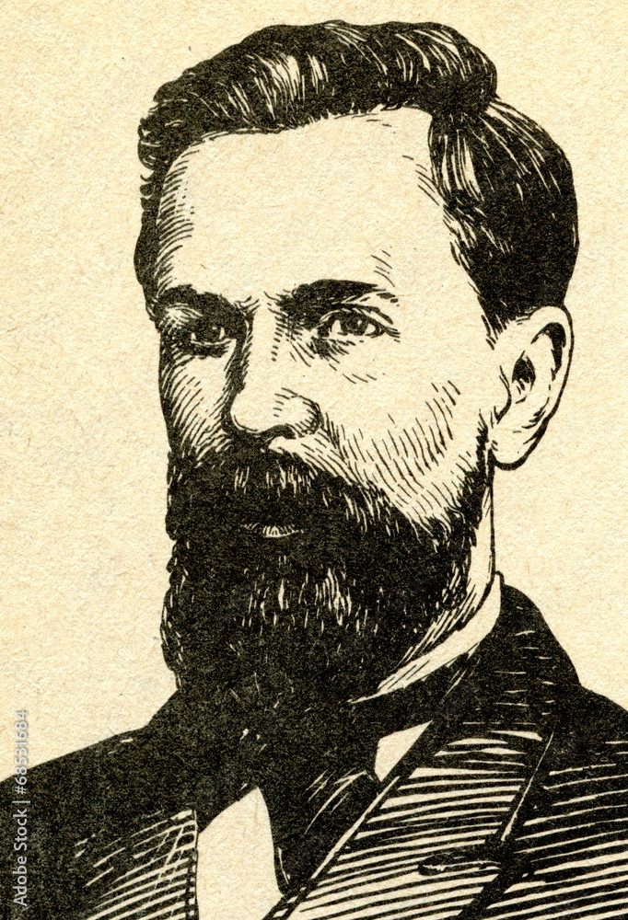
P(w₁w₂ …w_{n} ) ≈ ∏ P(w_{i}| w_{i− k} …w_{i−1})
Markov Assumption
Andrei Markov
i
The Markov assumption is the presumption that the future behavior of a dynamical system only depends on its recent history. In particular, in a kth-order Markov model, the next state only depends on the k most recent states, therefore an N-gram model is a (N−1)-order Markov model.
Notes:
Markov Assumption:
Instead of looking at the entire history of preceding words to predict the next word, we make an assumption that the probability of the next word depends only on the last k words.
Example: If k = 2, we only consider the probability of the next word based on the last two words.
Simplification: This simplifies the modeling process because we don't have to consider the entire context of the sentence, just the recent history.
Benefits: It reduces computational complexity and memory requirements, making it more feasible for practical language modeling tasks.

Slide 8


Unigram model
P(w₁w₂ …w_{n} ) ≈ ∏P(w_{i} )
i
Some automatically generated sentences from a unigram model
fifth, an, of, futures, the, an, incorporated, a, is,
a, the, inflation, most, dollars, quarter, in, mass, thrift, did, eighty, said, hard, July, bullish that, or, limited, the
Notes:
What is Unigram model?
The Unigram Model is a simple approach in language modeling where each word in a sentence is considered independently, without taking into account the surrounding words or context. In other words, it assumes that the probability of each word occurring in a sentence is only dependent on that particular word, regardless of the other words in the sequence.
Example:
In the unigram model, to estimate the likelihood of the word "cat" appearing in a sentence, we count how many times "cat" appears in the corpus and divide it by the total number of words in the corpus.
Sentence Generation:
When generating sentences using a unigram model, each word is chosen independently based on its probability of occurrence.
This can result in sentences that might not make much sense or lack coherence since there's no consideration of the relationships between words.

Slide 9

Bigram model
Condition on the previous word:
P(w_{i} | w₁w₂ …w_{i−1}) ≈ P(w_{i}| w_{i−1})
texaco, rose, one, in, this, a, boiler, house, said, mr., control, proposal, without, fifty, five, yen,
outside, new, car, parking,
issue, is, gurria,
pursuing, growth, in,
mexico,
's, motion,
permission, from, five, hundred,
lot, of, the, agreement, reached
this, would, be, a, record, november
Notes:
What is Bigram model?
The Bigram Model is a probabilistic model used in natural language processing (NLP) that considers the probability of each word in a sentence based on the occurrence of the preceding word. It's a step beyond the Unigram Model, which treats each word as independent. In the Bigram Model, the probability of a word occurring is dependent only on the previous word.
Example:
Suppose we have the sentence "The cat is black."
In the Bigram Model, to estimate the probability of "cat" given "the," we count how many times "the cat" appears in the corpus and divide it by the total number of occurrences of "the" in the corpus.
Sentence Generation:
When generating sentences using a Bigram Model, each word is chosen based on the probability of it following the preceding word.
This approach results in more coherent sentences compared to the Unigram Model, as it considers some context between adjacent words. However, it still has limitations, particularly with longer-range dependencies.

Slide 10

N- gram models
Estimate probability of each word given prior context.
P(phone | Please turn off your cell)
Number of parameters required grows exponentially with the number of words of prior context.
An N-gram model uses only N−1 words of prior context.
- Unigram: P(phone)
- Bigram: P(phone | cell)
- Trigram: P(phone | your cell)
Notes:
What is N-gram models?
The N-gram Models are an extension of the Bigram Model, where instead of considering only pairs of consecutive words, we consider sequences of N words. These models estimate the probability of a word based on the occurrence of the previous N-1 words.
Basic Idea:
N-gram models consider the probability of a word occurring in a sentence based on the context of the previous n-1 words.
They generalize the concept of the bigram model, where n equals 2.
Modeling Approach:
N-gram models estimate the likelihood of a word given the previous n-1 words using statistical techniques, typically based on relative frequencies observed in a corpus of text.
They capture dependencies between words within a fixed window of size n.
Example:
For example, in a bigram model (n=2), the probability of a word is estimated based on the preceding word.
In a trigram model (n=3), the probability of a word is estimated based on the two preceding words.

Slide 11
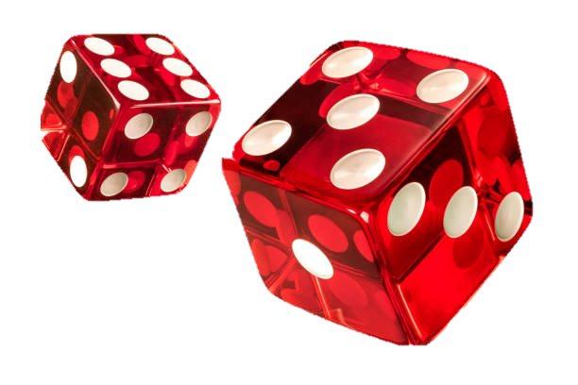
Generative Model & MLE
An N-gram model can be seen as a probabilistic automata for generating sentences.
Relative frequency estimates can be proven to be maximum likelihood estimates (MLE) since they maximize the probability that the model M will generate the training corpus T.
Initialize sentence with N−1 <s> symbols
Until </s> is generated do:
Stochastically pick the next word based on the conditional
probability of each word given the previous N −1 words.
Notes:
Basic Idea:
MLE is a statistical method used to estimate the parameters of a probability distribution based on observed data.
In the context of bigram probabilities, MLE is used to estimate the probability of a word occurring given the previous word.
Formula:
The MLE for the probability of a word w2 occurring after the word w1 is calculated as the count of the bigram (w1, w2) divided by the count of the unigram (w1).
Mathematically, it can be expressed as:
P(w2 | w1) = Count(w1, w2) / Count(w1)
Example:
Suppose we have a corpus of text with the sentence "The cat is black."
To estimate the probability of the word "cat" occurring after "the," we count how many times "the cat" appears in the corpus and divide it by the total count of "the" in the corpus.
This gives us the maximum likelihood estimate of the bigram probability P("cat" | "the").

Slide 12
Estimating Probabilities
N-gram conditional probabilities can be estimated from raw text based on the relative frequency of word sequences.
To have a consistent probabilistic model, append a unique start (<s>) and end (</s>) symbol to every sentence and treat these as additional words.
Bigram:
N-gram:
Notes:
Consistency: By adding start and end symbols (<s> and </s>) to every sentence, you ensure consistency in the treatment of the beginning and end of each sentence. This helps in modeling the probability of words at the beginning and end positions accurately.
Boundary Identification: The start (<s>) and end (</s>) symbols act as markers to identify the boundaries of sentences. This is particularly useful in tokenization and parsing tasks, where knowing the start and end of a sentence is important for accurate analysis.
Handling Context: Including start and end symbols allows the language model to consider the context of the first and last words in a sentence when estimating conditional probabilities. This improves the model's ability to capture sentence-level dependencies and produce more coherent text.
Avoiding Ambiguity: Start and end symbols ensure that the model treats the beginning and end of a sentence differently from regular words. This prevents ambiguity in estimating probabilities, especially for short or incomplete sentences.

Slide 13

Example from Textbook
P(<s> i want english food </s>)
= P(i | <s>) P(want | i) P(english | want)
P(food | english) P(</s> | food)
= .25 x .33 x .0011 x .5 x .68 = .000031
P(<s> i want chinese food </s>)
= P(i | <s>) P(want | i) P(chinese | want)
P(food | chinese) P(</s> | food)
= .25 x .33 x .0065 x .52 x .68 = .00019
Notes:
The task is to calculate the probability of each sentence using the provided formulae, which break down the probabilities into conditional probabilities of each word given the previous word.

Slide 14

Language Modeling Toolkits
SRILM
http://www.speech.sri.com/projects/srilm/
KenLM
https://kheafield.com/code/kenlm/
Notes:
These are the references for Language Modelling Toolkits
SRILM - The SRI Language Modeling Toolkit
KenLM Language Model Toolkit

Slide 15

Evaluation: How good is our model?
Does our language model prefer good sentences to bad ones?
Assign higher probability to “real” or “frequently observed” sentences
Then “ungrammatical” or “rarely observed” sentences?
We train parameters of our model on a training set.
We test the model’s performance on data we haven’t seen.
A test set is an unseen dataset that is different from our training set, totally unused.
An evaluation metric tells us how well our model does on the test set.
Notes:
Evaluation: In NLP, evaluation refers to assessing the performance of a language model or any NLP system. Evaluation can be done through various metrics, depending on the task at hand. For language models, common evaluation metrics include accuracy, precision, recall, F1-score, BLEU score (for machine translation), perplexity, etc. Evaluation helps researchers and practitioners understand how well a model performs on a given task and allows comparison with other models.

Slide 16

Training on the test set
We can’t allow test sentences into the training set
We will assign it an artificially high probability when we set it in the test set
“Training on the test set”
Bad science!
And violates the honor code
Notes:
Training on the test set is a big no-no in machine learning and violates fundamental principles of model evaluation and integrity. Here's why:
Data Contamination:
Including test sentences in the training set can lead to data contamination.
The model will effectively memorize these sentences, artificially inflating its performance on the test set.
Biased Evaluation:
By training on the test set, the model will perform well on sentences it has already seen, but it won't generalize well to new, unseen data.
Evaluation results will be biased and unreliable, providing a false sense of the model's performance.
Scientific Integrity:
Training on the test set violates basic principles of experimental design and scientific integrity.
It undermines the validity and reproducibility of research findings.
Honor Code:
Ethical considerations and honor codes in research prohibit such practices.
It's essential to uphold standards of academic honesty and integrity.

Slide 17
Extrinsic evaluation of N-gram models
Best evaluation for comparing models A and B
Put each model in a task
spelling corrector, speech recognizer, MT system
Run the task, get an accuracy for A and for B
How many misspelled words corrected properly
How many words translated correctly
Compare accuracy for A and B
Notes:
Extrinsic evaluation of N-gram models involves assessing their performance in a real-world application or task, rather than solely relying on intrinsic evaluation metrics like perplexity. While perplexity gives us an idea of how well a language model predicts text, extrinsic evaluation goes further by evaluating how well the language model performs in tasks where language understanding or generation is required.
Example:
Speech Recognition Task:
Task: Convert spoken language into text.
Evaluation Metric: Accuracy in transcribing spoken words correctly.
Procedure:
Use model A for speech recognition.
Use model B for the same speech recognition task.
Compare the accuracy of transcription for both models.
Comparison:
Evaluate and compare the accuracy of model A and model B in transcribing spoken words accurately.

Slide 18

Evaluation of Language Models
Ideally, evaluate use of model in end application (extrinsic, in vivo)
Realistic
Expensive
Evaluate on ability to model test corpus (intrinsic).
Less realistic
Cheaper
Verify at least once that intrinsic evaluation correlates with an extrinsic one.
Notes:
The main difference between extrinsic and intrinsic evaluation lies in the focus of the evaluation and the type of assessment performed:
Intrinsic Evaluation:
Focus: Intrinsic evaluation assesses the performance of a model directly based on its internal characteristics or capabilities.
Type of Assessment: It involves evaluating the model in isolation, typically using specific metrics or measures that are inherent to the model itself.
Examples: Perplexity in language modeling, accuracy in classification tasks, BLEU score in machine translation, etc.
Purpose: Intrinsic evaluation helps understand how well the model performs on a particular aspect of the task without considering its performance in a real-world application.
Extrinsic Evaluation:
Focus: Extrinsic evaluation assesses the performance of a model in the context of a specific real-world application or task.
Type of Assessment: It involves evaluating the model's performance within a broader system or application, considering its effectiveness in achieving the end goal of the task.
Examples: Human evaluation of text generated by a language model, accuracy of speech recognition in a dialogue system, relevance of search results in information retrieval, etc.
Purpose: Extrinsic evaluation provides insights into how well the model performs in practical scenarios and its impact on user experience or task completion.

Slide 19
Intuition of Perplexity
mushrooms 0.1
pepperoni 0.1
anchovies 0.01
….
fried rice 0.0001
….
and 1e-­100
The Shannon Game:
How well can we predict the next word?
I always order pizza with cheese and
The 33rd President of the US was
I saw a
Unigrams are terrible at this game. (Why?)
A better model of a text
is one which assigns a higher probability to the word that actually occurs
Notes:
What is Perplexity?
Perplexity is a measure often used in natural language processing, particularly in language modeling, to assess how well a model predicts a given sequence of words. It's a bit abstract, but here's an intuition that might help:
Imagine you have a language model—a sort of "machine mind" that's trying to predict the next word in a sequence based on the words that came before it. Perplexity is a measure of how surprised or "perplexed" this model is when it sees a new sequence of words.
"Unigrams are terrible at this game." (Why?):
Unigrams refer to single words treated independently of each other. In this context, using unigrams for prediction means considering each word in isolation. Unigrams are not effective at capturing the context and dependencies between words, making them unsuitable for predicting the next word in a sequence accurately.
"A better model of a text": A better model for predicting the next word in a sequence would consider not only the current word but also the context provided by the preceding words. Models like bigrams, trigrams, or more sophisticated neural network-based models (such as recurrent neural networks or transformers) can capture these contextual dependencies more effectively, leading to more accurate predictions.

Slide 20

Measure of how well a model “fits” the test data.
Uses the probability that the model assigns to the test corpus.
Normalizes for the number of words in the test corpus and takes the inverse.
Measures the weighted average branching factor in predicting the next word (lower is better).
Notes:
The chain rule of probability, applied in the context of bigram models (where the probability of a word depends only on the preceding word), allows us to decompose the probability of a sentence into a product of conditional probabilities of each word given its predecessor. By maximizing the conditional probabilities of words given their preceding words, we can maximize the overall probability of the sentence, leading to lower perplexity.

Slide 21

Lower perplexity = better model
Sample Perplexity Evaluation
Models trained on 38 million words from the Wall Street Journal (WSJ) using a 19,979 word vocabulary.
Evaluate on a disjoint set of 1.5 million WSJ words.
 | Unigram | Bigram | Trigram
Perplexity | 962 | 170 | 109
Notes:
As we move from unigram to trigram models, the perplexity decreases, indicating that the models are improving in their ability to predict the test data. Therefore, according to these perplexity values, the trigram model performs the best among the three, followed by the bigram model, and then the unigram model.
Lower perplexity generally corresponds to a better language model, as it indicates that the model is better at predicting unseen data. Therefore, based on the perplexity values provided, the trigram model would be considered the best model for the given dataset and test set.

Slide 22

Difference between N-gram and bi-gram
N-gram | Bi-gram
An N-gram is a contiguous sequence of N items from a given sample of text or speech. These items can be characters, phonemes, syllables, or words, depending on the application. | A bigram is a specific type of N-gram where N is equal to 2, meaning it consists of a sequence of two adjacent words in a sentence or text.
The "N" in N-gram represents the number of items in the sequence. For example, a bigram is a 2-gram, a trigram is a 3-gram, and so on. | Bigrams are commonly used in language modeling tasks, where the goal is to predict the next word in a sequence based on the preceding words.
N-grams are widely used in various natural language processing tasks, including language modeling, machine translation, and speech recognition. | Bigram models estimate the probability of observing a word given its immediately preceding word, capturing local word dependencies in the text.
N-grams capture the sequential dependencies between words or units of text and are used to model the probability of observing a particular sequence of words in a given language or domain. | Bigrams are a simple but effective way to model language and are often used as the basis for more complex N-gram models.
What are the reasons to avoid using
N-grams in all situations?
while N-gram models are versatile and widely used in natural language processing, their effectiveness depends on various factors such as data sparsity, computational resources, generalization requirements, context sensitivity, and task/domain specificity. It's important to carefully consider these factors and potentially explore alternative modeling approaches when using N-gram models may not be the best choice for a particular task or scenario.
Notes:
Example:
Let's say we have the movie review:
"The acting was not good, but the plot was interesting." A bigram model might consider the bigram "not good" as a negative sentiment indicator, missing the overall positive sentiment conveyed by the phrase "the plot was interesting." A more sophisticated model like BERT, which considers the entire sentence and understands the context of words like "not," would likely provide a more accurate sentiment classification.

Slide 23

The Shannon Visualization Method
Choose a random bigram
(<s>, w) according to its probability
Now choose a random bigram (w, x) according to its probability
And so on until we choose </s>
Then string the words together
<s> I
I want
want to
to eat
eat
Chinese Chinese
food food
</s>
I want to eat Chinese food
Notes:
What is Shannon Visualization method?
The Shannon Visualization Method is a technique used in data visualization, specifically for multidimensional data analysis. It's named after Claude Shannon, an American mathematician, electrical engineer, and cryptographer, known as "the father of information theory.”
Here's a simplified explanation of how it works:
Data Preparation: Start with a dataset that has multiple dimensions or variables. These variables could represent various aspects or features of the data points.
Dimensionality Reduction: Apply dimensionality reduction techniques, such as Principal Component Analysis (PCA) or Multidimensional Scaling (MDS), to reduce the number of dimensions while retaining as much relevant information as possible. These techniques aim to transform the data into a lower-dimensional space.
Visualization: Once the dimensionality is reduced, the data can be visualized in two or three dimensions. This visualization helps in understanding the underlying structure or patterns within the data that may not be apparent in its original high-dimensional form.
Interpretation: Analyze the visualization to gain insights into the relationships, clusters, or trends present in the data. By visually inspecting the reduced-dimensional representation of the data, analysts can make interpretations and draw conclusions about the dataset.

Slide 24
Shakespeare as corpus
N=884,647 tokens, V=29,066
Shakespeare produced 300,000 bigram types out of V²= 844 million possible bigrams.
So, 99.96% of the possible bigrams were never seen (have zero entries in the table)
Quadrigrams worse: What's coming out looks like Shakespeare because it is Shakespeare

Slide 25
The wall street journal is not shakespeare (no offense)
1
Months the my and issue of year foreign new exchange’s september were recession exchange new endorsed a acquire to six executives
Last December through the way to preserve the Hudson corporation N.
B. E. C. Taylor would seem to complete the major central planners one point five percent of U. S. E. has already old M. X. corporation of living on information such as more frequently fishing to keep her
They also point to ninety nine point six billion dollars from two hundred four oh six three percent of the rates of interest stores as Mexico and Brazil on market conditions
gram
2
gram
3
gram
Notes:
A snippet of text that resembles financial news or data, possibly from the Wall Street Journal. The text mentions topics such as foreign exchange rates, corporate acquisitions, economic indicators, and market conditions.
1-gram: Refers to individual words or tokens in the text.
2-gram: Refers to sequences of two consecutive words (bigrams).
3-gram: Refers to sequences of three consecutive words (trigrams).

Slide 26
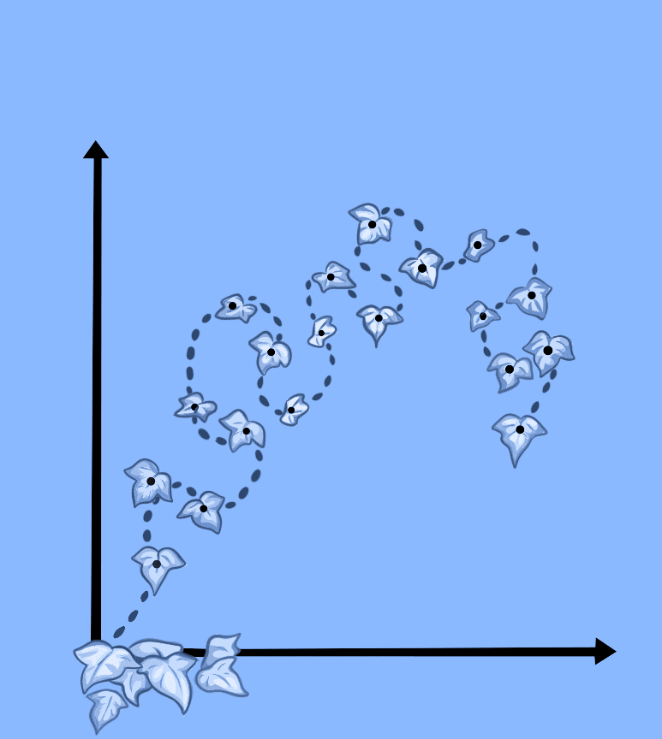
The perils of overfitting
N- grams only work well for word prediction if the test corpus looks like the training corpus
In real life, it often doesn’t
We need to train robust models that generalize!
One kind of generalization: Zeros!
Things that don’t ever occur in the training set
But occur in the test set
Notes:
The perils of overfitting in language modeling highlight the importance of training robust models that can generalize well to unseen data, especially in scenarios where the test data differs significantly from the training data. Handling zeros and employing techniques to improve generalization are essential steps in building reliable and effective language models.

Slide 27

Zero probability bigrams
Bigrams with zero probability
mean that we will assign 0 probability to the test set!
And hence we cannot compute perplexity (can’t divide by 0)!
Notes:
Zero probability bigrams refer to combinations of two consecutive words (bigrams) that have not occurred in the training data. In language modeling and natural language processing tasks, calculating the probability of a word given its preceding word (i.e., the conditional probability of a word given a context) is crucial for tasks like text generation, machine translation, and speech recognition.
When a bigram has a zero probability, it means that in the training data, the specific combination of words has never occurred. This situation can arise due to various reasons:
Rare Events: Some combinations of words may be extremely rare or unique, occurring very infrequently or not at all in the training corpus.
Limited Data: In datasets with limited size or diversity, it's common for certain word combinations to have zero occurrences, especially for longer or more specific phrases.
Sparsity: Natural language data tends to exhibit sparsity, meaning that only a small fraction of possible word combinations are observed in any given corpus. As a result, many bigrams may have zero probabili

Slide 28
The intuition of smoothing (from Dan Klein)
When we have sparse statistics:
P(w | denied the) 3 allegations
2 reports
1 claims
1 request
7 total
Steal probability mass to generalize better
P(w | denied the)
2.5 allegations
1.5 reports
0.5 claims
0.5 request
2 other
7 total
allegations
reports
attack
man outcome
claims
request
…
allegations
allegations
outcome
reports
attack
man
…
claims
request
Notes:
Dan Klein's intuition on smoothing in the context of language modeling revolves around addressing the issue of zero probabilities for unseen events, particularly in the context of bigram or n-gram models.
To generalize better and avoid assigning zero probabilities to unseen events, smoothing techniques redistribute probability mass from observed events to unseen ones.
By redistributing probability mass in this manner, the smoothed probability estimates provide more robust and generalized predictions for unseen events. This allows the language model to make reasonable predictions even for word combinations that were not present or were rare in the training data.
Dan Klein's intuition on smoothing emphasizes the importance of addressing sparsity in language modeling by redistributing probability mass to unseen events. This approach improves the generalization ability of the model and leads to more accurate predictions, particularly in situations where data is limited or certain combinations are rare.

Slide 29
Smoothing
Since there are a combinatorial number of possible word sequences, many rare (but not impossible) combinations never occur in training, so MLE incorrectly assigns zero to many parameters (a.k.a. sparse data).
If a new combination occurs during testing, it is given a probability of zero and the entire sequence gets a probability of zero (i.e. infinite perplexity).
In practice, parameters are smoothed (a.k.a. regularized) to reassign some probability mass to unseen events.
Adding probability mass to unseen events requires removing it from seen ones (discounting) in order to maintain a joint distribution that sums to 1.
Notes:
Smoothing is a technique used in Natural Language Processing (NLP) to address the problem of zero probabilities that arise when estimating probabilities of unseen events in language models, particularly in the context of N-gram models.
In NLP, language models are often trained on a corpus of text data to estimate the probability of a word or sequence of words occurring in a given context. However, in practice, it's common to encounter unseen word sequences, leading to zero probabilities for those sequences.
Smoothing techniques aim to alleviate this issue by redistributing some probability mass from seen events to unseen events, ensuring that no event has a probability of zero. This helps improve the robustness and generalization of the language model.

Slide 30
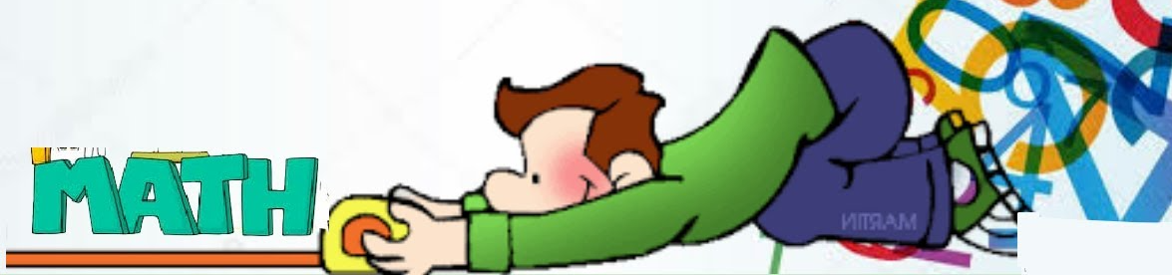
Laplace (Add-One) Smoothing
“Hallucinate” additional training data in which each possible N-gram occurs exactly once and adjust estimates accordingly.
where V is the total number of possible (N−1)-grams (i.e. the vocabulary size for a bigram model).
Bigram:
N-gram:
Tends to reassign too much mass to unseen events, so can be adjusted to add 0<δ<1 (normalized by δV instead of V).
Notes:
What is Add – One Equation?
Add-one (or Laplace) smoothing is a technique commonly used in probabilistic models, including N-gram language models, to address the issue of zero probabilities for unseen events. In the context of N-gram language models, Add-one smoothing involves adding a count of one to every possible event (word sequence) in the training data before calculating probabilities. This additional count effectively redistributes probability mass from seen events to unseen ones, ensuring that no event is assigned a zero probability.
The basic idea behind Add-one smoothing is to make the probability estimate for each event more robust by incorporating a small amount of "pseudo-counts" to account for unseen events.
By adding one to both the numerator and the denominator, Add-one smoothing ensures that even unseen events receive a non-zero probability estimate. However, it also introduces bias towards unseen events, which can affect the overall performance of the language model. Despite its simplicity, Add-one smoothing is widely used due to its ease of implementation and its effectiveness in improving the robustness of probabilistic models, especially when dealing with limited training data.

Slide 31
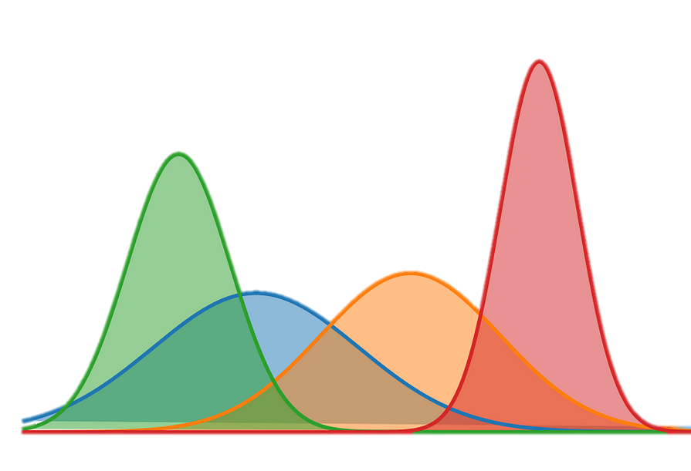
Maximum Likelihood Estimates
The maximum likelihood estimate
of some parameter of a model M from a training set T
maximizes the likelihood of the training set T given the model M
Suppose the word “bagel” occurs 400 times in a corpus of a million words
What is the probability that a random word from some other text will be “bagel”?
MLE estimate is 400/1,000,000 = .0004
This may be a bad estimate for some other corpus
But it is the estimate that makes it most likely that “bagel” will occur 400 times in a million word corpus.
Notes:
Maximum Likelihood Estimation (MLE) is a common method used to estimate the parameters of a statistical model based on observed data. In the context of language modeling, MLE is often used to estimate the probabilities of words or sequences of words based on a training corpus.
The intuition behind MLE is to choose the parameters of the model that maximize the likelihood of observing the training data. In other words, we seek the parameter values that make the observed data the most probable under the assumed statistical model.
Maximum Likelihood Estimation provides a straightforward and intuitive way to estimate model parameters based on observed data. However, it can lead to issues such as overfitting, especially when dealing with limited data or sparse events.

Slide 32
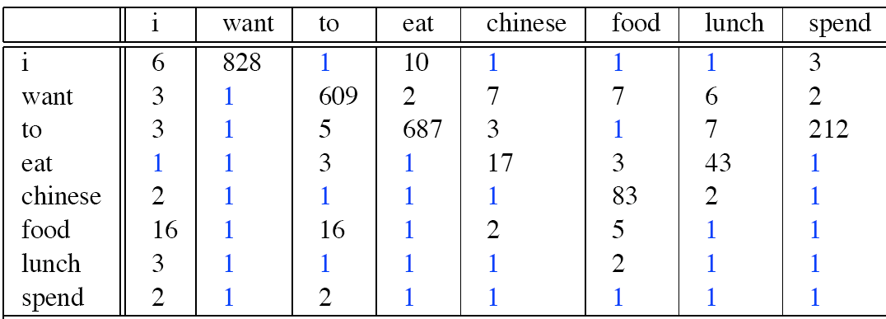
Berkeley Restaurant Corpus: Laplace smoothed bigram counts
Notes:
The Berkeley Restaurant Corpus is a dataset commonly used in natural language processing research, particularly in the context of language modeling and machine learning tasks. It consists of reviews of restaurants in the Berkeley area, along with corresponding ratings and other metadata.
To calculate Laplace-smoothed bigram counts for the Berkeley Restaurant Corpus, we first need to determine the counts of observed bigrams in the corpus. Then, we apply Laplace smoothing by adding one to each observed count and adjust for the vocabulary size.
Calculate observed bigram counts in the Berkeley Restaurant Corpus.
Apply Laplace smoothing to each observed count by adding one.
Adjust for the vocabulary size.
These adjusted counts represent the Laplace-smoothed bigram counts for the Berkeley Restaurant Corpus. They ensure that even unseen bigrams have non-zero counts, helping improve the robustness of language modeling and prediction tasks.

Slide 33
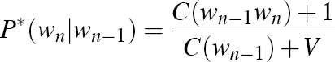
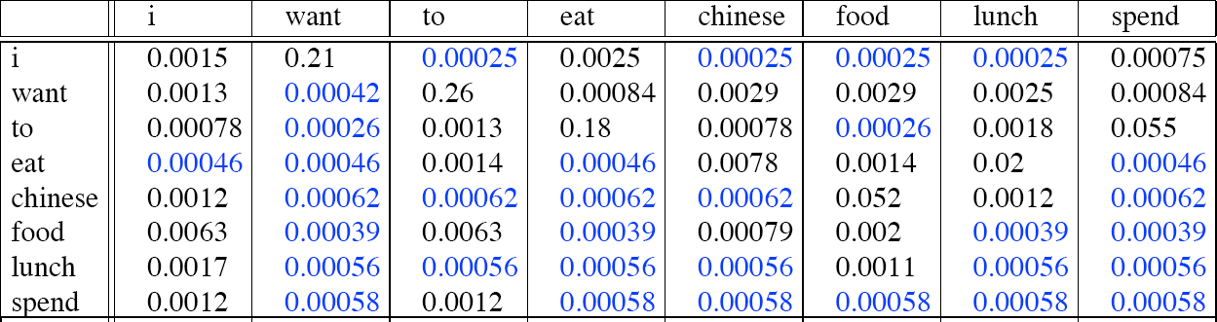
Laplace-­smoothed bigrams
Notes:
To calculate Laplace-smoothed bigrams, we'll follow these steps:
Count the occurrences of each bigram in the corpus.
Apply Laplace smoothing by adding one to each observed count.
Adjust for the vocabulary size by adding the vocabulary size to the denominator (Probabilities).
These adjusted probabilities represent the Laplace-smoothed bigram probabilities for the Berkeley Restaurant Corpus. They ensure that even unseen bigrams have non-zero probabilities, improving the robustness of language models.

Slide 34
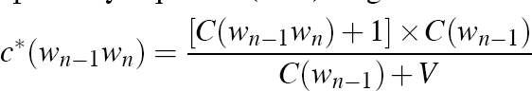
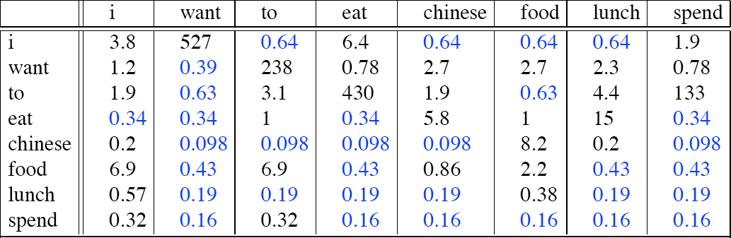
Reconstituted counts
Notes:
Reconstituted counts, also known as adjusted counts or smoothed counts, refer to the counts of events in a dataset after applying a smoothing technique such as Laplace smoothing. In the context of language modeling and n-gram models, reconstituted counts are used to estimate the probabilities of events (such as word sequences) based on observed data while mitigating the impact of sparsity and unseen events.
To calculate reconstituted counts after Laplace smoothing, we typically add a small constant value (such as 1) to each observed count and adjust for the vocabulary size. Here's how the process works:
Count the occurrences of each event: This involves counting the occurrences of each event (such as bigrams) in the dataset.
Apply Laplace smoothing: Add a small constant value (usually 1) to each observed count to account for unseen events. This ensures that no event has a zero count.
Adjust for the vocabulary size: Adjust the counts to account for the total number of unique events in the dataset. This helps normalize the counts and prevent overly inflated probabilities for rare events.

Slide 35
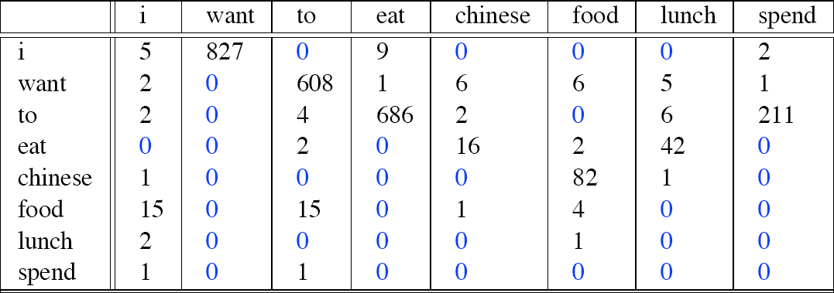
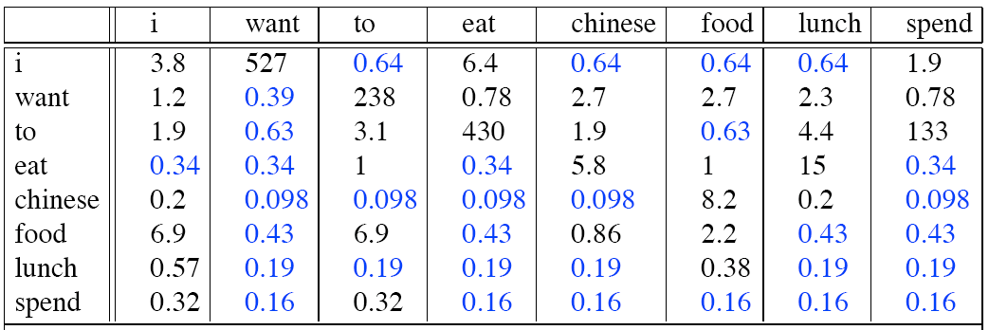
Compare with raw bigram counts
Notes:
Raw Bigram Counts: These are the observed counts of each bigram in the dataset without any smoothing or adjustment. They represent the actual occurrences of each bigram as observed in the corpus.
Reconstituted Counts: These are the counts of each bigram after applying a smoothing technique, such as Laplace smoothing. Smoothing involves adding a small constant value (e.g., 1) to each observed count to mitigate the impact of sparsity and unseen events.
Difference:
The difference between raw bigram counts and reconstituted counts lies in the application of Laplace smoothing. Reconstituted counts ensure that each bigram has a non-zero count, which helps improve the robustness of the language model, particularly in cases of sparse data or unseen events. Raw bigram counts, on the other hand, represent the actual observed occurrences in the corpus without any adjustment.

Slide 36
Backoff
Only use lower-order model when data for higher-order model is unavailable (i.e. count is zero).
Recursively back-off to weaker models until data is available.
Where P* is a discounted probability estimate to reserve mass for unseen events and α’s are back-off weights (see text for details).
Notes:
Backoff:
Backoff is a technique that involves using lower-order n-grams to estimate the probabilities of higher-order n-grams when the higher-order n-grams have insufficient training data.
When a higher-order n-gram is not observed in the training data, backoff involves "backing off" to a lower-order n-gram and using its probability estimate instead.
For example, if the probability of a trigram is not available, we can back off to the corresponding bigram or unigram probabilities to estimate the trigram probability.
Backoff models are typically simpler and computationally more efficient than interpolation models, but they may suffer from data sparsity issues and may not capture long-range dependencies as effectively.
Interpolation:
Interpolation is a more sophisticated technique that combines probability estimates from multiple n-gram models, typically using linear interpolation.
Instead of relying solely on a single n-gram model (e.g., a bigram or trigram model), interpolation combines information from multiple models, such as unigram, bigram, and trigram models.
Each n-gram model contributes a weighted probability estimate, and these estimates are linearly combined to obtain the final probability estimate for a given n-gram.
Interpolation allows the model to smoothly transition between different n-gram orders based on the availability of training data, resulting in more robust and accurate probability estimates.
However, interpolation models may be more complex and computationally intensive compared to backoff models but works better than Backoff model.

Slide 37
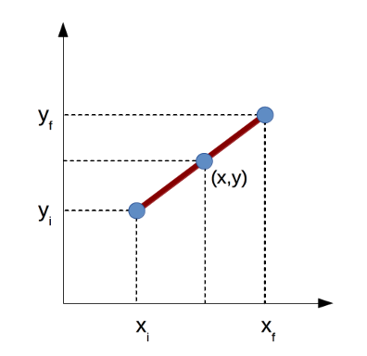
Interpolation
Linearly combine estimates of N-gram models of increasing order.
Interpolated Trigram Model:
Where:
Learn proper values for λ_{i} by training to (approximately) maximize the likelihood of an independent development (a.k.a. tuning) corpus.
Notes:
What is Linear Interpolation? Linear interpolation is a technique used in language modeling to combine probability estimates from multiple n-gram models. It is commonly employed in smoothing methods, particularly in interpolation-based approaches, to address the issue of data sparsity and improve the robustness of probability estimates.
In linear interpolation, the probability estimate for a given n-gram is obtained by linearly combining the probability estimates from different n-gram models. Typically, these models include unigram, bigram, trigram, and possibly higher-order n-gram models.
Simple Interpolation:
Simple interpolation, also known as linear interpolation, is a technique used in language modeling to combine probability estimates from multiple n-gram models in a straightforward manner. It involves linearly interpolating between the probabilities estimated by different n-gram models based on their relative importance or contribution.
Lambdas conditional:
When using interpolation techniques in language modeling, it's common to adjust the interpolation weights, often denoted as lambdas (λ), based on the context of the n-gram being evaluated. This approach, known as context-dependent interpolation, allows for more flexible and adaptive smoothing by dynamically weighting the contributions of different n-gram models based on the context of the current sequence.

Slide 38

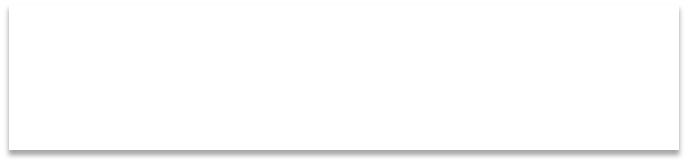



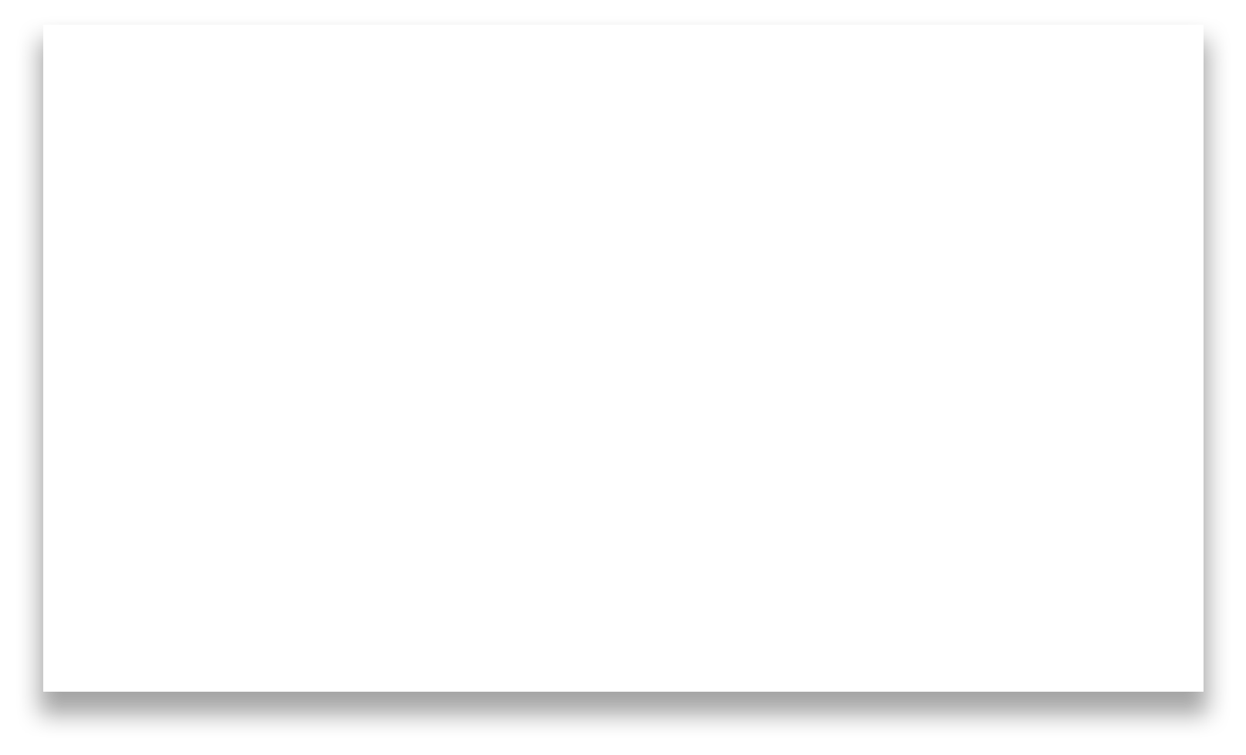
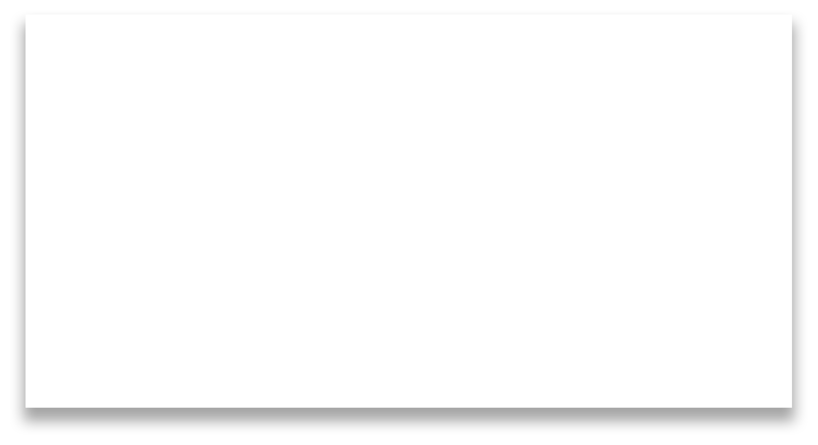
How to set the lambdas?
Use a held – out corpus
Training Data
Held - out Data
Test Data
Choose λs to maximize the probability of held – out data:
Fix the N-gram probabilities (on the training data)
Then search for λs that give largest probability to held- out set:
log P(w₁...w_{n} | M (λ₁...λ_{k} )) = ∑log P_{M (λ1...λk )} (w_{i} | w_{i−1} )
i
Notes:
Setting the lambdas (λ) for interpolation in language modeling involves determining the relative importance or contribution of each n-gram model to the final probability estimate. To set the interpolation weights (λs) to maximize the probability of held-out data, you can follow these steps:
Split the Data:
Estimate N-gram Probabilities:
Optimize Interpolation Weights:
Objective Function:
Optimization Method:
Validation:
By maximizing the probability of the held-out set, you can select the interpolation weights that result in the best generalization performance for your language model. This approach helps prevent overfitting to the training data and ensures that the model performs well on unseen data.

Slide 39

Open versus closed vocabulary tasks
If we know all the words in advanced
Vocabulary V is fixed
Closed vocabulary task
Often, we don’t know this
Out Of Vocabulary = OOV words
Open vocabulary task
Instead: create an unknown word token <UNK>
Training of <UNK> probabilities
Create a fixed lexicon L of size V
At text normalization phase, any training word not in L changed to <UNK>
Now we train its probabilities like a normal word
At decoding time
If text input: Use UNK probabilities for any word not in training
Notes:
Examples of tasks that fall into each category include:
Closed Vocabulary Tasks:
Speech recognition: The system recognizes words from a fixed set of known vocabulary during transcription. Unknown words may be represented by a special token.
Part-of-speech tagging: The system assigns part-of-speech tags to words based on a predefined set of tags. Unknown words may be assigned a default tag.
Open Vocabulary Tasks:
Language modeling: The system predicts the likelihood of word sequences, including unseen words not present in the training data. Techniques like sub-word tokenization or character-level modeling can help handle unknown words.
Information retrieval: The system retrieves relevant documents or passages based on user queries, which may contain previously unseen terms. The system must be able to handle and understand new terms it encounters during retrieval.
Closed vocabulary tasks assume a fixed vocabulary and employ specific handling mechanisms for unknown words, while open vocabulary tasks require the system to handle any encountered word, including those that were not seen during training. Handling unknown words effectively is crucial for the robustness and performance of natural language processing systems.

Slide 40

Huge web-scale n-grams
How to deal with, e.g., Google N-gram corpus
Pruning
Only store N-grams with count>threshold.
Remove singletons of higher-order n-grams
Entropy-based pruning
• Efficiency
Efficient data structures like tries
Bloom filters: approximate language models
Store words as indexes, not strings
Use Huffman coding to fit large numbers of words into two bytes
Quantize probabilities (4-8 bits instead of 8-byte float)
Notes:
What is Huge web – scale n – grams: Huge web-scale n-grams refer to n-gram language models trained on vast amounts of text data extracted from the web. These language models capture statistical patterns and relationships between words, phrases, or characters in the text and are used in various natural language processing (NLP) tasks such as machine translation, speech recognition, text generation, and information retrieval.
Example:
Text: "The cat sat on the mat."
We can generate different n-grams (sequences of words) from this text:
Unigrams (1-grams):
"The", "cat", "sat", "on", "the", "mat"
Bigrams (2-grams):
"The cat", "cat sat", "sat on", "on the", "the mat"
Trigrams (3-grams):
"The cat sat", "cat sat on", "sat on the", "on the mat"
These n-grams capture different sequences of words present in the text. For example, the bigram "The cat" represents the sequence of words "The" followed by "cat", and the trigram "sat on the" represents the sequence "sat", "on", and "the" occurring together in the text.

Slide 41

Smoothing for Web – Scale N-grams
“Stupid backoff” (Brants et al. 2007)
No discounting, just use relative frequencies
⎧
count(w^{i} )
⎮
i−k+1
if count(w^{i} ) > 0
S(w | w^{i−1} ) = ⎨
i i−k+1
⎮
⎮⎩
count(w^{i−1} )
i−k+1
i−k+1
0.4S(w | w^{i−1} )
i i−k+2
otherwise
count(w )
S(w ) =
i
i
N
Notes:
Smoothing techniques like Laplace smoothing can also be applied to large-scale N-gram models used in web-scale applications. These applications often deal with massive amounts of text data, making traditional smoothing approaches computationally expensive and impractical. Here are some strategies for smoothing large-scale N-grams:
Parallelization:
Approximation Techniques:
Sampling:
Incremental Smoothing:
Distributed Databases
Compression Techniques:
By employing these strategies, you can effectively smooth N-gram models at web-scale, enabling efficient language modeling and natural language processing in large-scale web applications.

Slide 42

Comparison
Key Points | Laplace | Interpolation | Backoff | Web-scale
1) Effectiveness in Handling Unseen Events: | Adds a small pseudo-count to all events, effectively handling unseen events. However, it tends to over-smooth and can lead to poor performance with large vocabularies. | Combines probabilities from lower-order and higher-order N-grams, providing a more nuanced estimation of unseen events. Generally effective in handling unseen events. | Uses lower-order N-grams to estimate probabilities of higher-order N-grams. Can struggle with unseen events that occur with higher-order N-grams but are not present in lower-order ones. | Designed for very large-scale N-grams encountered in web-scale applications. May use simpler techniques like Stupid Backoff due to computational constraints.
2) Model Complexity: | Simple to implement and understand. Adds a constant value to all counts. | Moderately complex, involving interpolation of probabilities from multiple N-gram orders. | Relatively simple, but involves decision-making based on lower-order N-grams. | Complexity varies based on the specific algorithm used (e.g., Stupid Backoff). Generally designed for efficiency and scalability.
3) Computational Efficiency: | Can be computationally expensive for large vocabularies due to the need to add a pseudo-count to every event. | Moderately efficient but, requires calculating probabilities for multiple N-gram orders. | Generally, more efficient than interpolation, as it relies on lower-order N-grams. | Designed for efficiency in handling very large-scale N-grams encountered in web-scale applications. May sacrifice some accuracy for computational speed.
4) Performance in Language Modeling: | Generally, not the best choice for language modeling due to over-smoothing. | Provides better performance by combining probabilities from multiple N-gram orders, capturing more nuanced dependencies. | Effective for language modeling tasks, especially when dealing with large vocabularies and sparse data. | Optimized for web-scale language modeling, balancing accuracy with computational efficiency.
5) Scalability: | Scales poorly with large vocabularies due to the need to add a pseudo-count to every event. | Scales reasonably well, but computational requirements increase with the number of N-gram orders considered. | Generally scalable, especially when using simpler techniques like Stupid Backoff. | Specifically designed for scalability in handling very large-scale N-grams encountered in web-scale applications. Focuses on efficiency and parallelization.
Notes:
Comparison of 4 models

Slide 43

Language models assign a probability that a sentence is a legal string in a language.
They are useful as a component of many NLP systems, such as ASR, OCR, and MT.
Simple N-gram models are easy to train on unsupervised corpora and can provide useful estimates of sentence likelihood.
MLE gives inaccurate parameters for models trained on sparse data.
Smoothing techniques adjust parameter estimates to account for unseen (but not impossible) events.
Notes:
Overall, N-gram smoothing plays a crucial role in building accurate and robust language models that can effectively handle unseen events and generalize well to new data.

Slide 44


